Slide 1

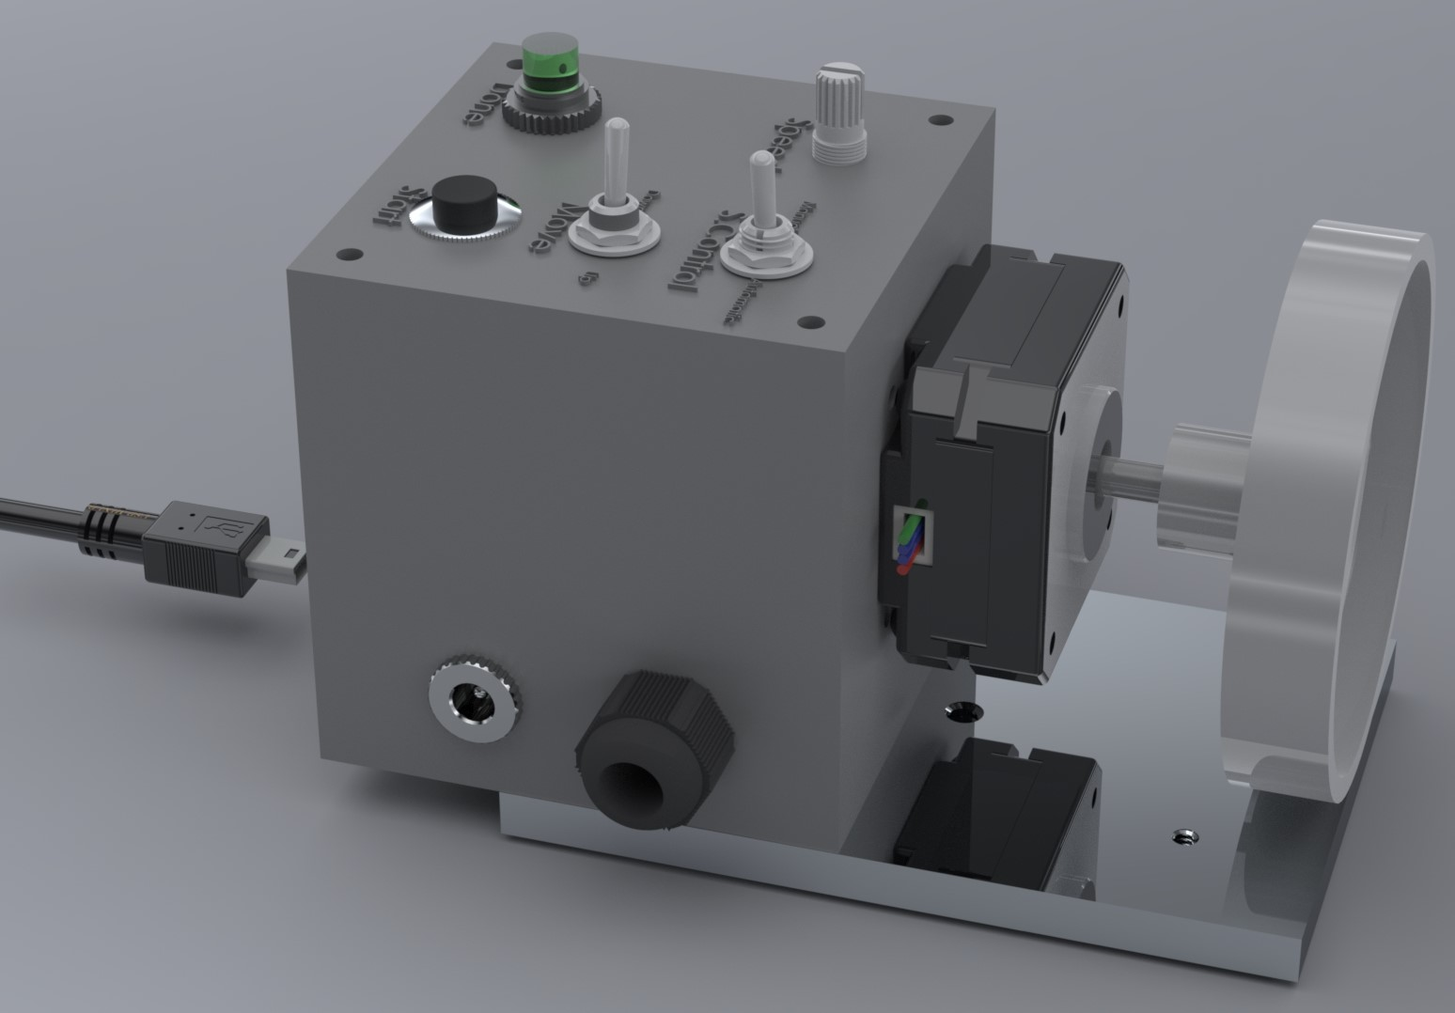
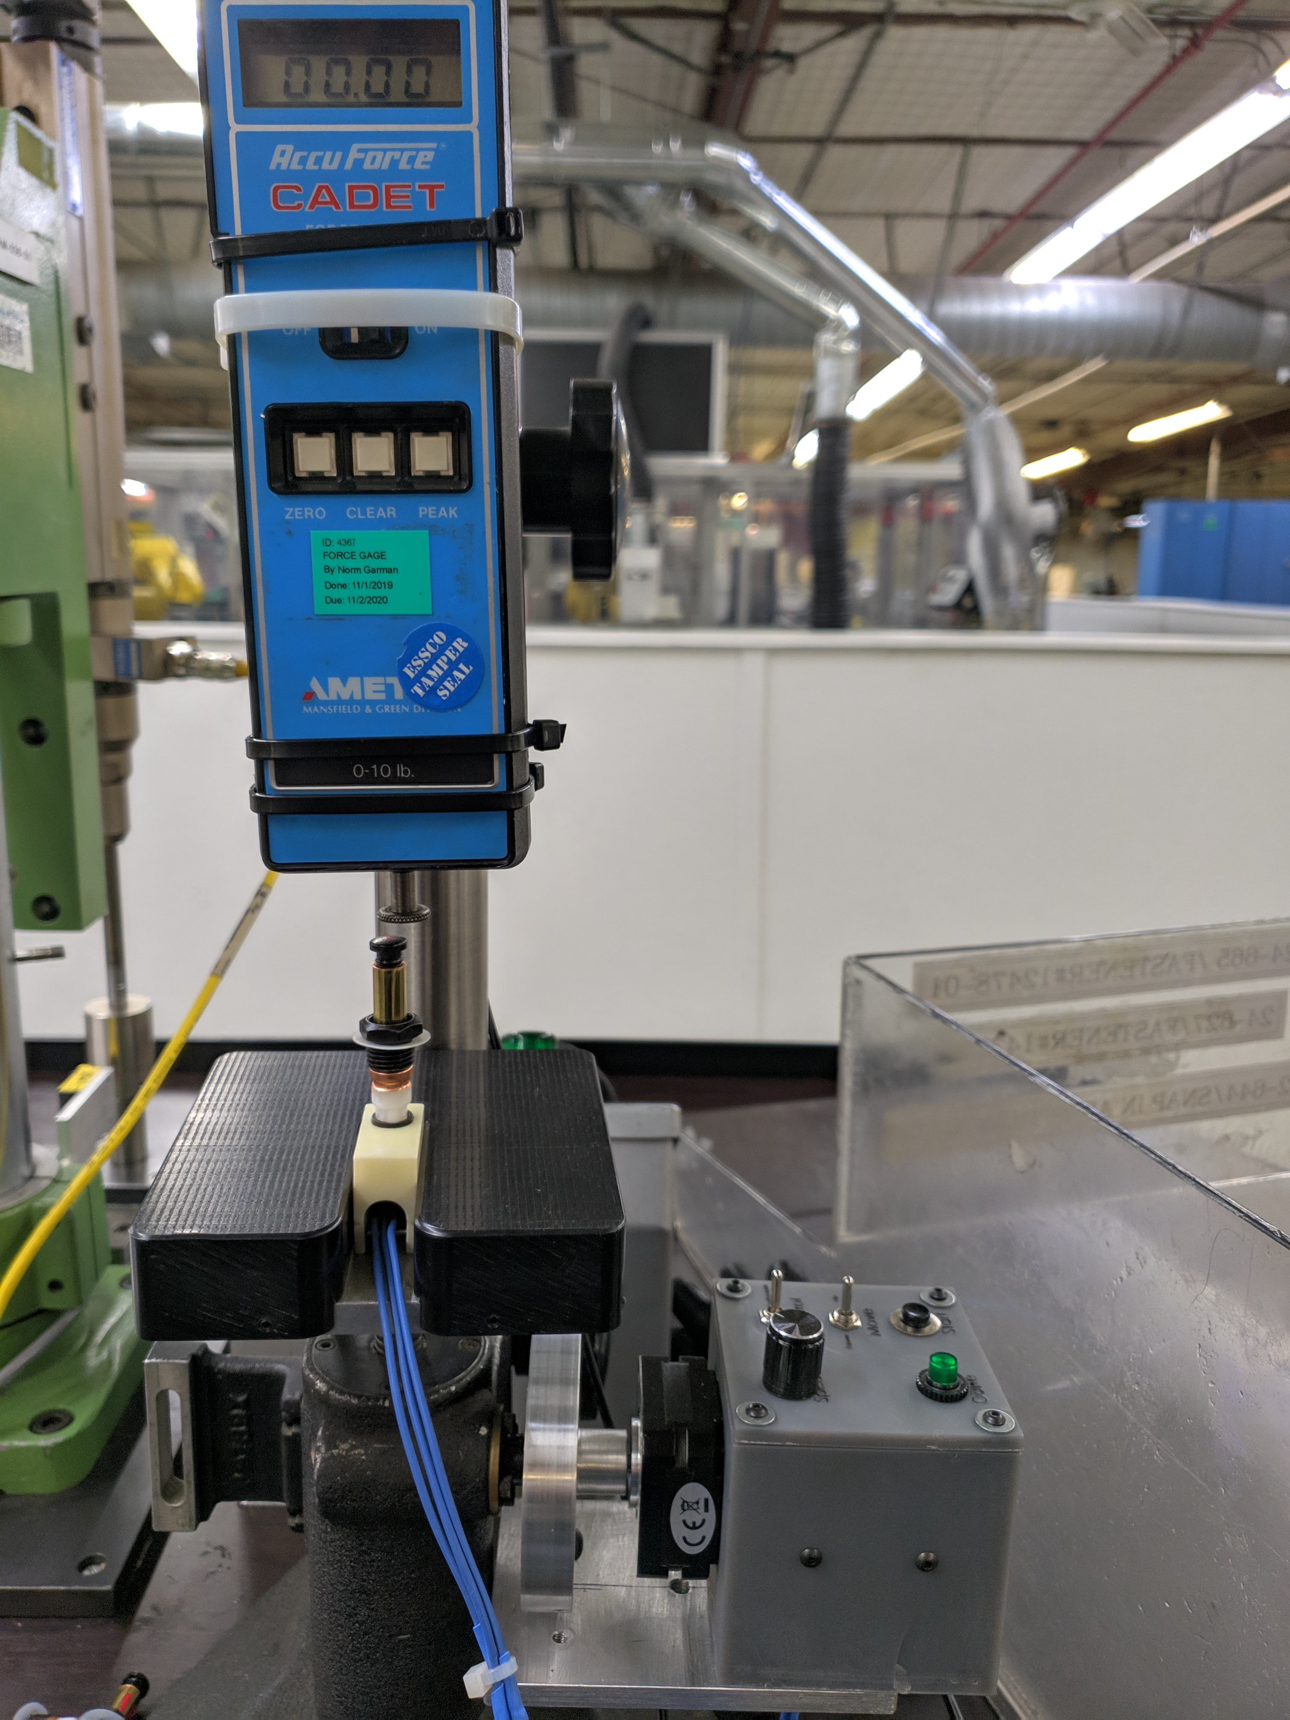
Ford Courtesy Light Switch Tester
By: Luis Chachayma
PROJECT OVERVIEW
Quality verification of auto parts is important to guarantee vehicle safety and satisfaction. Parts are required to past a Capability Study to verify its correct functioning.
The project was to develop an automated force measurement station to test 1 Courtesy Light Switch at a time. The test has the following considerations:
The test consists on applying a vertical force on Courtesy Light Switch at until the switch is activated.
Once the switch is activated the force should be measured immediately.
The procedure must be repeated with 30 parts.
The daily calculated Cpk is calculated and it must be lower than 1.5
Tester Rendering
TESTER DEVELOPMENT
The current test is done manually with an Arbor press. The issue is that the press is operated manually with a handle and the speed is not constant.
The unsteady speed makes the force, required to activate the switch, too variable.
A variable activation force produces a low Cpk.
To overcome this variability, a Stepper Motor was coupled to the actuation mechanism of the press.
The motor was controlled by an Arduino Nano through a Servo Motor Driver.
Knobs were added to control the speed and the direction of the motor rotation.
For the test, the quality engineer needs to press a button and the press will close until the Switch is activated. Once the Switch is activated the LED indicator turns ON and the press stops.
Tester implemented
Notes:
1

